Slide 1
Module 1: Boolean & Digital Logic
EN605.204 Computer Organization

Slide 2
Introduction
How do bits change/flow through digital circuits?
What is Boolean logic?
How do digital circuits implement Boolean logic?
Boolean Logic

Slide 3
What is a “bit”?
Computer circuits are based on Boolean algebra
Boolean algebra operates on 1's and 0's
Claude Shannon showed the relationship between Boolean algebra and digital circuits in 1930's
Boolean Logic

Slide 4
Logical NOT
Takes in a single bit as input and negates ("flips") it
Can be denoted using the ~ or ¬ character
Input (X) | Output (¬X)
0 | 1
1 | 0
Boolean Logic

Slide 5
Logical OR
Takes two bits as input and outputs a 1 if either input was a 1
Can be denoted using the ∨, ⋃, or + character
Input (X, Y) |  | Output (X∨Y)
0 | 0 | 0
0 | 1 | 1
1 | 0 | 1
1 | 1 | 1
Boolean Logic

Slide 6
Logical AND
Takes two bits as input and outputs a 1 if both inputs were 1
Can be denoted using the ∧, ⋂, or * character
Input (X, Y) |  | Output (X∧Y)
0 | 0 | 0
0 | 1 | 0
1 | 0 | 0
1 | 1 | 1
Boolean Logic

Slide 7
Logical XOR
Two bits as input and outputs a 1 if exactly one input was a 1
Can be denoted using the ⊗ character
Input (X, Y) |  | Output (X⊗Y)
0 | 0 | 0
0 | 1 | 1
1 | 0 | 1
1 | 1 | 0
Boolean Logic

Slide 8
Logical NOR
Two bits as input and outputs a 1 if no inputs were a 1
Input (X, Y) |  | Output ¬(X∨Y)
0 | 0 | 1
0 | 1 | 0
1 | 0 | 0
1 | 1 | 0
Boolean Logic

Slide 9
Logical NAND
Two bits as input and outputs a 1 if at least 1 bit was a 0
Input (X, Y) |  | Output ¬(X∧Y)
0 | 0 | 1
0 | 1 | 1
1 | 0 | 1
1 | 1 | 0
Boolean Logic

Slide 10
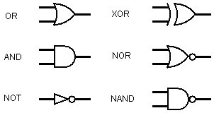
Logic Gates
Boolean Logic

Slide 11
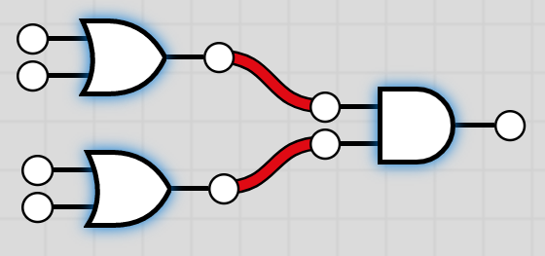
Combinational Logic
Computer logic is implemented using physical "gates"
Gates can be strung together to build more complex logic
Example: AND(OR(W, X), OR(Y, Z))
Input: {0, 0, 0, 1}
= AND(OR(0, 0), OR(0, 1))
= AND(0, 1)
= 0
Boolean Logic

Slide 12
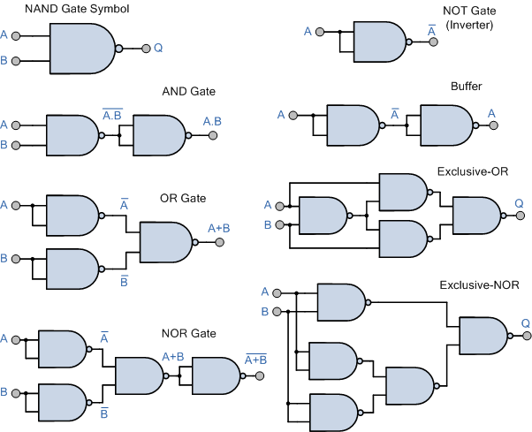
Universal Logic Gates
NOR and NAND gates are "universal"; they can simulate any logical operation
Boolean Logic

Slide 13
Laws of Boolean Logic
Input (X, Y) | Output ¬(X∧Y)
Identity | X∧1 = X | X∨0 = X
Complementation | X∧¬X = 0 | X∨¬X = 1
Double Negation | ¬(¬X) = X
Idempotent | X∧X = X | X∨X = X
Dominance | X∧0 = 0 | X∧1 = 1
Commutative | X∧Y = Y∧X
Associative | X∧Y∧Z = X∧(Y∧Z) = (X∧Y)∧Z
Distributive | X∧(Y∨Z) = (X∧Y)∨(X∧Z) X∨(Y∧Z) = (X∨Y)∧(X∨Z)
Boolean Logic

Slide 14
DeMorgan's Law
(X OR Y) and (X AND Y) are called "propositions"
¬(X OR Y) = ¬X AND ¬Y
The proposition X OR Y fails if X and Y are false
Ex: "I don't like the Cowboys (X) or Patriots (Y)" = "I don't like the Cowboys (X) and I don't like the Patriots (Y)."
¬(X AND Y) = ¬X OR ¬Y
The proposition fails if either X is false or Y is false
Ex: "I don't want a sandwich unless it has both ham (X) and cheese (Y)." = "I don't want a sandwich if it doesn't ham (X) or if it doesn't have cheese (Y)."
Boolean Logic

